Slide 1
Paul
in
Chains

Slide 2
Paul
in
Chains

Slide 3
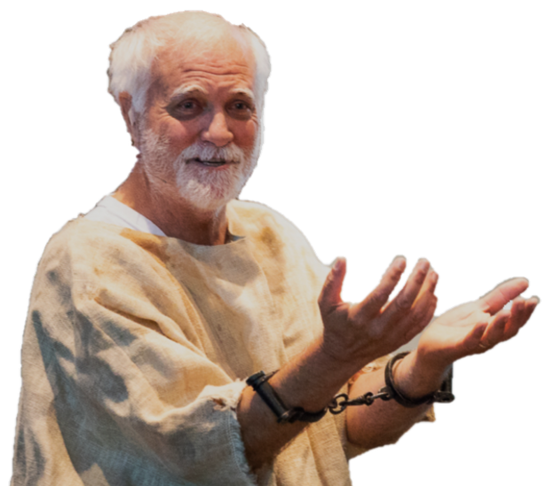
Paul in Chains
The Letter to the Philippians

